Slide 1


Over-Approximating Neural Networks for Verification, Robustness, and Explainability
PhD Defense, 19/12/2025
Serge DURAND (CEA). PhD Candidate ED-STIC, Paris-Saclay
Co-supervisor: Zakaria CHIHANI (DILS/LSL)
Co-supervisor: Caterina URBAN (ENS/Inria ANTIQUE)
Director: François TERRIER (DRT/LIST)

Slide 2
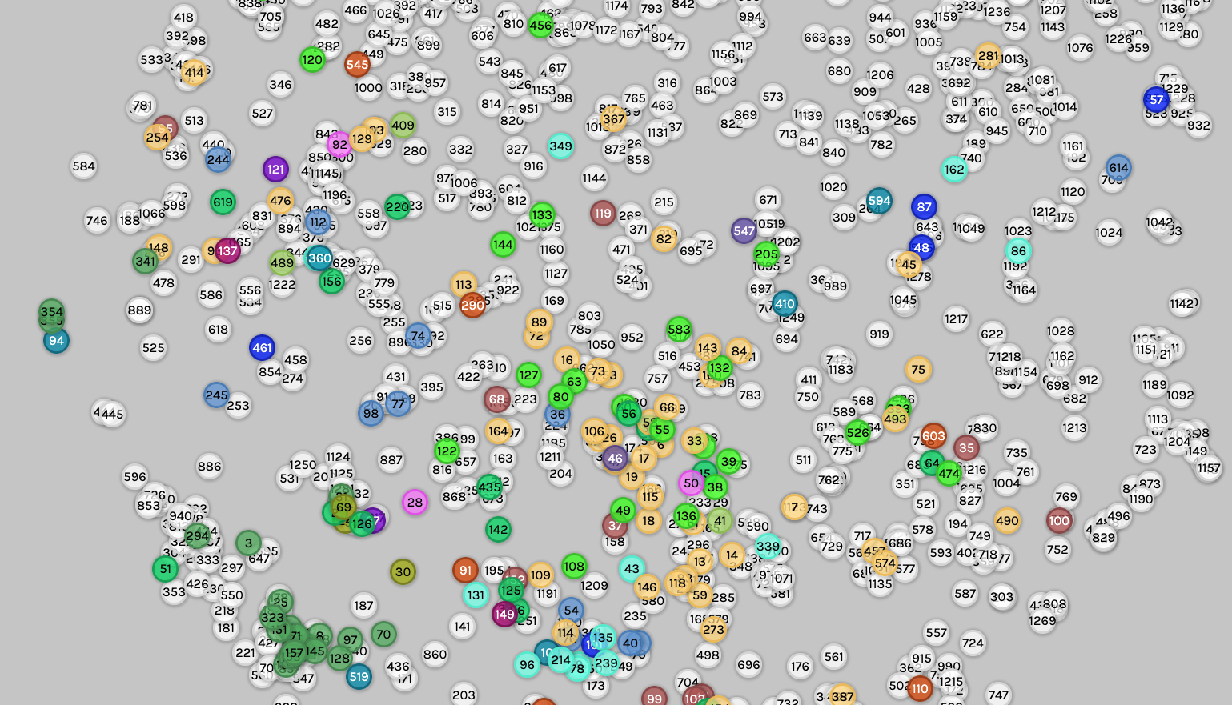
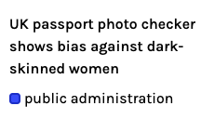
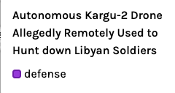
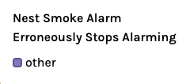

The need for trustworthy AI
More than 1200 incidents reported!
The AI Incident Database https://incidentdatabase.ai/
Notes:
First let’s motivate the need for trustworthy AI if anyone still needs convincing:
List of incidents
Exemple includes safety, biases, unethical use, loss of life

Slide 3
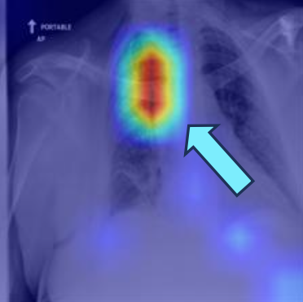

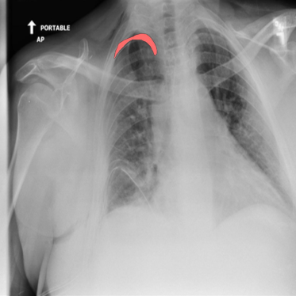

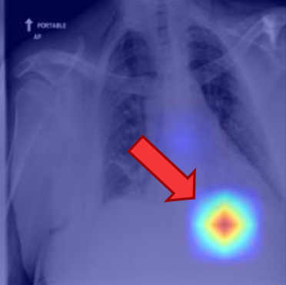

Aspects of Trustworthiness
Verification
Proving the model has the desired behavior
Robust training
Enforcing the stable prediction on similar inputs at training time
Explainability
Highlight the reason behind the decision of the model
Correct
Error
$$f_{θ^{′}}$$

Slide 4
Verifying Neural Networks
1

Slide 5
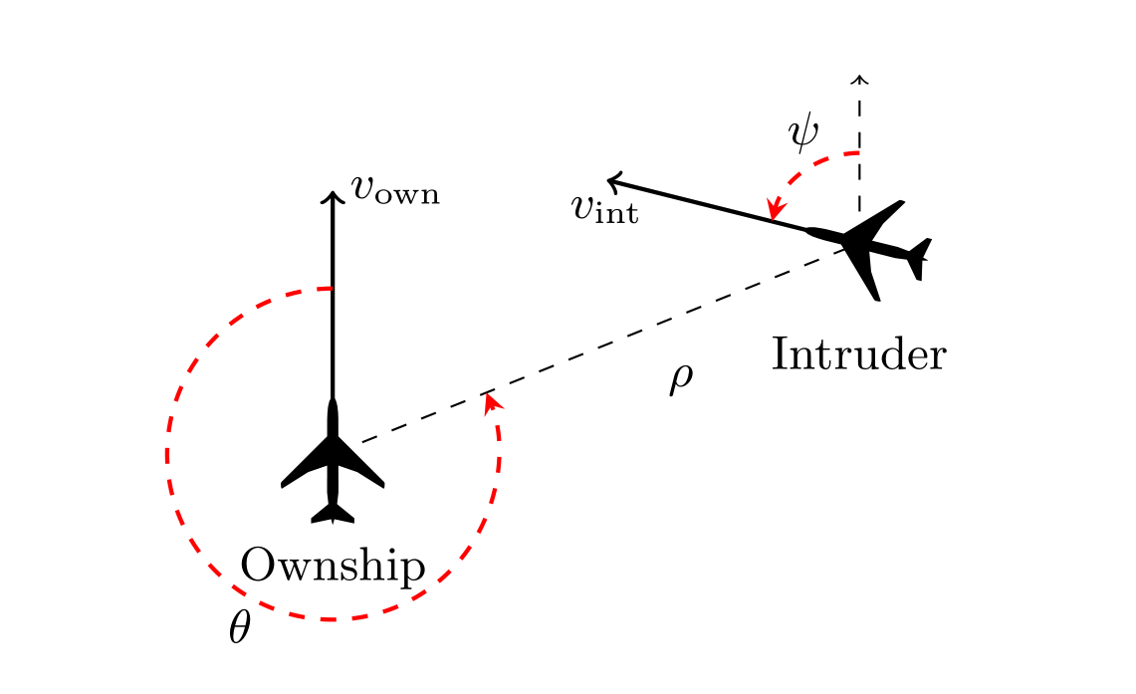
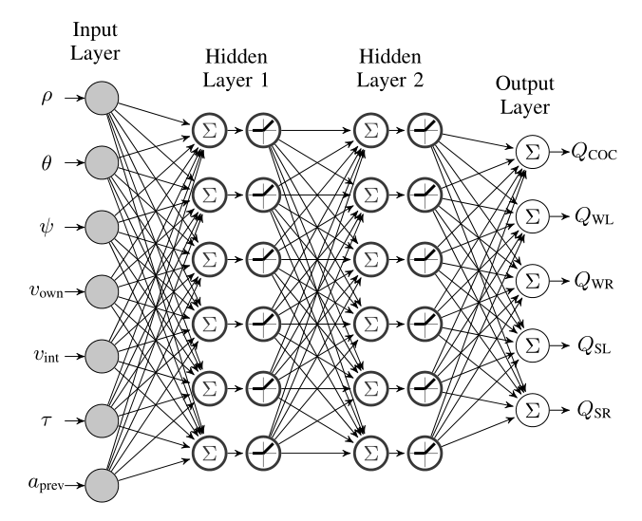
Global Safety
Property: If the intruder is directly ahead and is moving towards the ownship, the Clear of Conflict command should not be advised
Reluplex: An Efficient SMT Solver for Verifying Deep Neural Networks [Katz 2017]
Notes:
Neural network verification is particularly important for safety-critical applications. Here we have an example of a network designed to prevent aircraft collisions. On the right I show a simplified version of the neural network. It is composed of several layers. The inputs are processed by the sequential application of linear functions followed by a non-linear activation function.

Slide 6
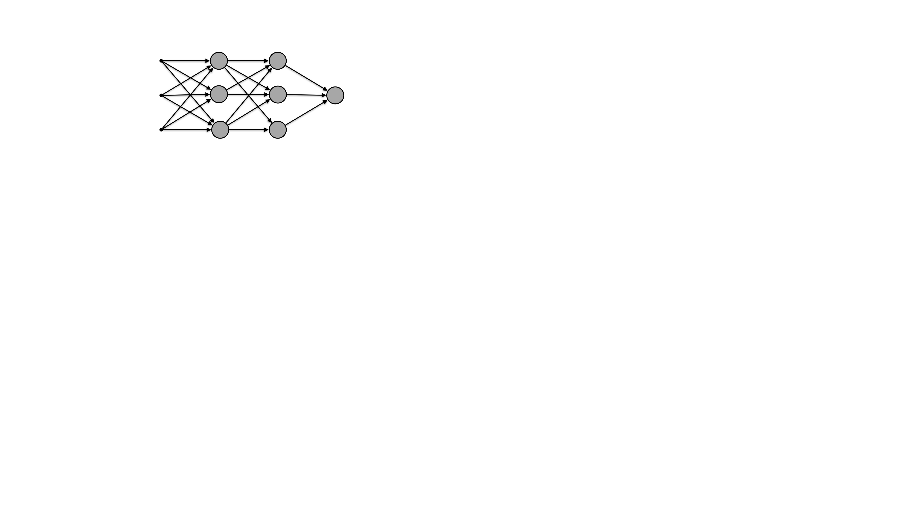
Verification of Neural Networks
Input-output properties
Correct
Error
$$f_{θ}$$
$$f_{θ}()?$$
Notes:
This is an example of input output property.
Such properties can be defined by :
An input set, representing possibly infinitely many inputs
A trained network, here with some fixed given parameters theta
And a safe output space, here for instance a half space, defined by the hyperplane in red.
Any outputs above the hyperplane are considered correct outputs, and the other are errors.

Slide 7

Exact Verification
Correct
NP-Complete [Katz2017]
Safe :)
Error
Correct
Unsafe :(
Error
$$f_{θ}$$
Reluplex: An Efficient SMT Solver for Verifying Deep Neural Networks [Katz 2017]

Slide 8
Over-approximating Neural Networks
$$\left(\begin{aligned}x_{1} \\ x_{2}\end{aligned}\right)$$
$$\left(\begin{aligned}o_{1} \\ o_{2}\end{aligned}\right)$$
Layer 1
Layer 2
Layer 3
Layer k
Input space
Exact reachable space and its over-approximation

Slide 9
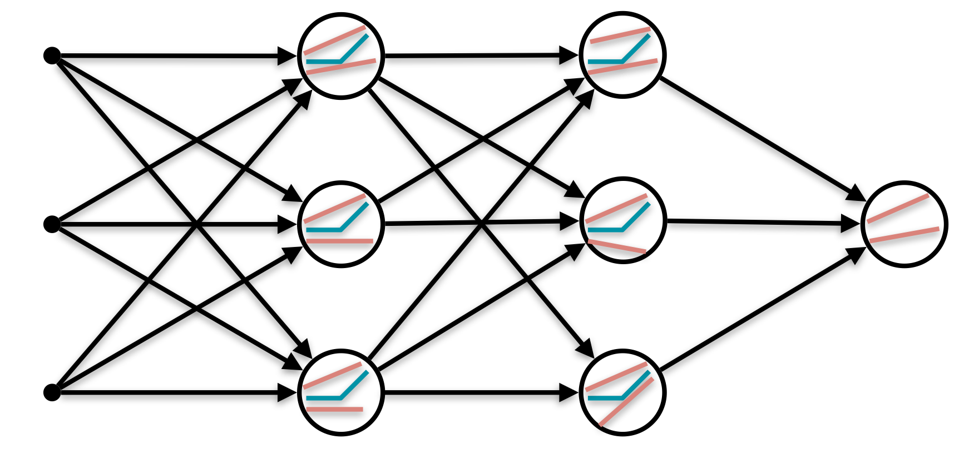
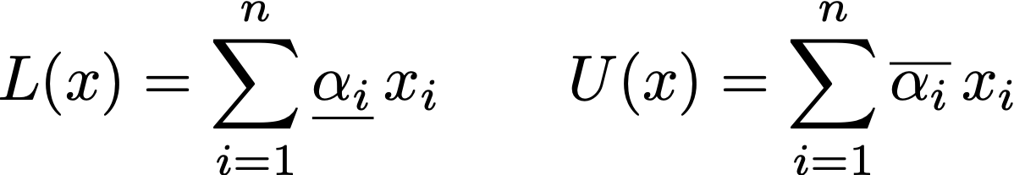
Linear Approximations
$$f_{θ}$$
Notes:
Principle : propagating upper and lower bounding linear functions through the network.

Slide 10

Over-approximations for verification
Correct
Safe!
Error
$$f_{θ}()⊂$$
Unknown
Correct
$$f_{θ}$$
Error

Slide 11

Input partitioning
Correct
Correct
Correct
Error
Error
Error
False Alarm ?
1) Partition the input space
2 ) Solve two verification problems
Formal Security Analysis of Neural Networks using Symbolic Intervals [Wang 2018]

Slide 12
Iterative input partitioning
X1: [-1,1]
X2: [-1,1]
X2: [-1,0]
X2: [0,1]
X1: [-1,0]
X1: [0,1]
X2: [0;0.5]
X2: [0.5,1]
Notes:
The process can be repeated and subproblems handled in parallel.
Theoretical convergence (asymptotic complete verification) depends on the linear approximation used.
In practice : repetitive splits do lead to shrinking of the output space, but analysis can timeout (property is unsafe with hard counter examples, network has a large number of inputs…)
Prioritizing inputs to be partitioned is key for efficient analysis.

Slide 13
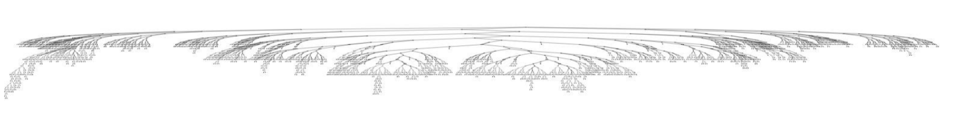
“Real life” example
Industrial Use Case
3133 subproblems to solve!

Slide 14
Existing heuristics:
Random
Largest interval
Gradient Smear [ReluVal, Wang 2018]
Over-approximation of the outputs (symbolic intervals for ReluVal)
$$×$$
Our proposal: reuse information already computed during the over-approximation
backward pass to bound input gradients given pre-computed output bounds.
Final score: largest upper bound times input width
Formal Security Analysis of Neural Networks using Symbolic Intervals [Wang 2018]

Slide 15
ReCIPH: (Relational coefficient for input partitioning heuristic)
ReCIPH score for the input $x_{i}=\frac{|\underset{¯}{α_{i}}|+|\overline{α_{i}}|}{2}⋅(u_{i}-l_{i})$
Variable to split first: highest ReCIPH score
Notes:
Average of the magnitude of linear coefficient applied to the input in lower and upper approximations,
Scaled by the width of the input bounds.
Intuition: if we shrink this input interval the result in the output interval will be the highest. Note: sum would work the same…

Slide 16
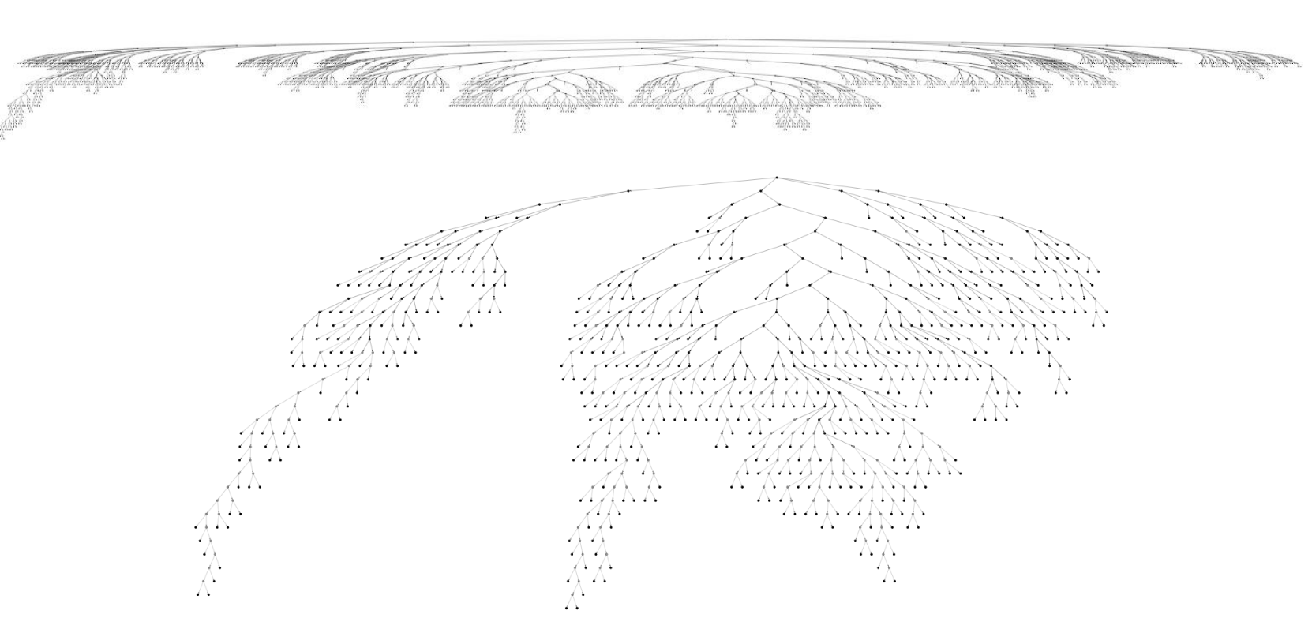
Impact on our use case
3113 subproblems
879 subproblems
Notes:
From 3 800

Slide 17
ACAS Xu benchmark
Reported metric: number of subproblems
Properties | Width | ReCIPH | Gradient Smear
1 | 68 567 | 15 289 | 16 521
3 | 319 306 | 16 140 | 209 924
4 | 25 906 | 1 828 | 2 206
5 | 142 637 | 7 023 | 29 169
9 | 3 055 | 2 395 | 3 877
10 | 1 331 | 335 | 217

Slide 18
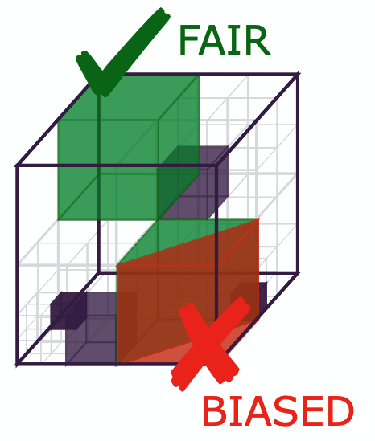


Wider applicability
LIBRA (Fairness analysis)
PyRAT : 6/12 benchmarks in VNN-COMP 2024 where PyRAT finished 2 / 8 tools
Verification remains a hard challenge!
VNN Comp 2024 report, Verifying Neural Networks with PyRAT [Lemesle 2025], The Fifth International Verification of Neural Networks Competition (VNN-COMP 2024): Summary and Results [Brix 2024]
LIBRA https://caterinaurban.github.io/project/libra/

Slide 19
Over-Approximations for Empirical Robustness
2

Slide 20
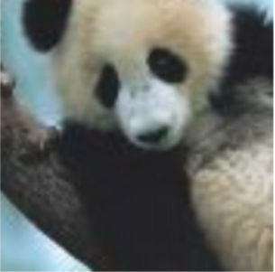
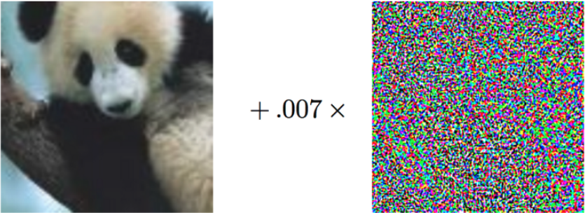
Local Robustness
Pandas (57.7% confidence)
Gibbon (99.3% confidence)
Explaining and Harnessing Adversarial Examples [Goodfellow 2015]

Slide 21
Neural Network Supervised Training
Error of the prediction (estimated with a loss function)
$$f_{θ}(x)$$
$$x$$

Slide 22
Neural Network Supervised Training
After minimizing the error
$$f_{θ^{′}}(x)$$
Updated parameters $θ^{′}$
$$x$$

Slide 23
Robust Training
Certified Training (CT)
Worst case of the over-approximation of the reachable space
$$f_{θ}()$$
On the Effectiveness of Interval Bound Propagation for Training Verifiably Robust Models [Gowal 2018]

Slide 24
Robust Training
Certified Training (CT)
Minimizing the worst-case of the approximation: leads to tighter approximation
$$f_{θ^{′}}()$$
Updated parameters $θ^{′}$
On the Effectiveness of Interval Bound Propagation for Training Verifiably Robust Models [Gowal 2018]

Slide 25

Robust Training
Adversarial Training (AT)
Output computed on an adversarial perturbation
$$f_{θ}(x_{adv})$$
On the Effectiveness of Interval Bound Propagation for Training Verifiably Robust Models [Gowal 2018]

Slide 26
Robust Training
Adversarial Training (AT)
Minimizing the error on adversarial perturbations: leads to better empirical robustness
$$f_{θ^{′}}(x_{adv})$$
Updated parameters $θ^{′}$
On the Effectiveness of Interval Bound Propagation for Training Verifiably Robust Models [Gowal 2018]

Slide 27
Combining Certified and Adversarial Training
(CT + AT)
AT
CT
$$α=0$$
$$α=1$$
$$α∈[0,1]$$
Expressive Losses for Verified Robustness via Convex Combinations [De Palma 2024]

Slide 28
Trade-offs
CIFAR-10, CNN-7, $ϵ$ = 8 / 255.
Training Method | Standard (%) | Empirical (%) | Verified (%)
Standard | 91.27 | 0 | 0
AT | 77.07 | 40.14 | 0
CT | 48.51 | 35.48 | 34.97
CT + AT | 53.35 | 36.02 | 35.44
CTBench: A Library and Benchmark for Certified Training [Mao 2024]

Slide 29
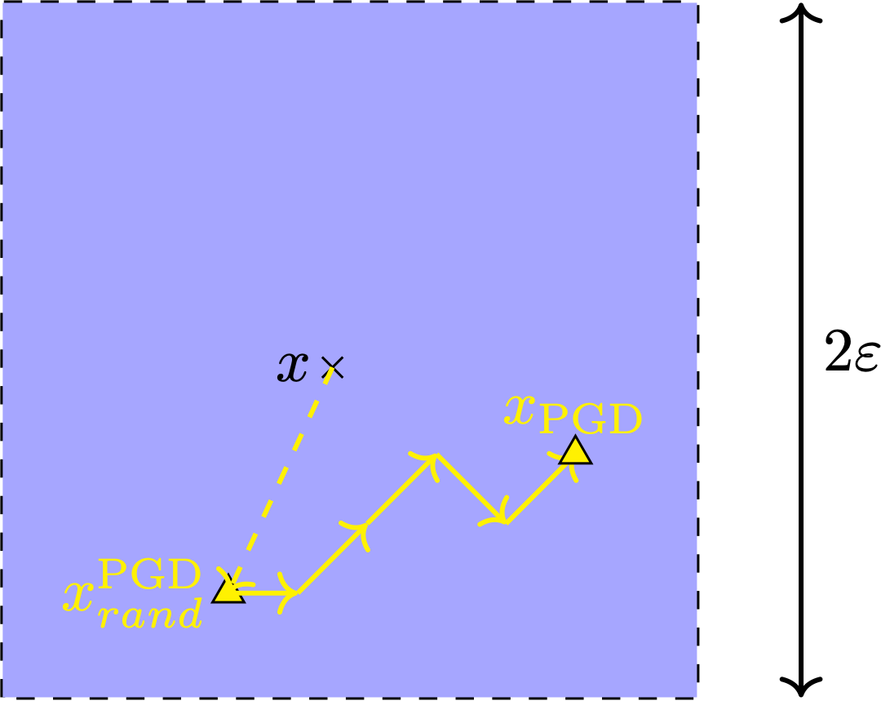
Cost of adversarial training:
PGD
Towards Deep Learning Models Resistant to Adversarial Attacks [Madry 2018]

Slide 30
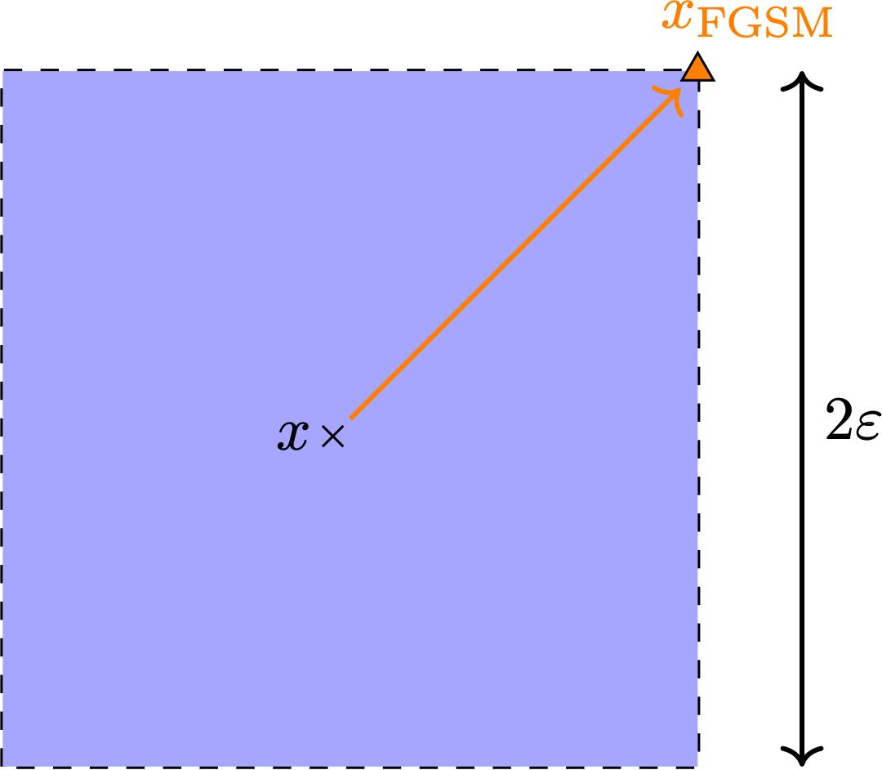
Single Step Training?
FGSM
Explaining and Harnessing Adversarial Examples [Goodfellow 2015]

Slide 31
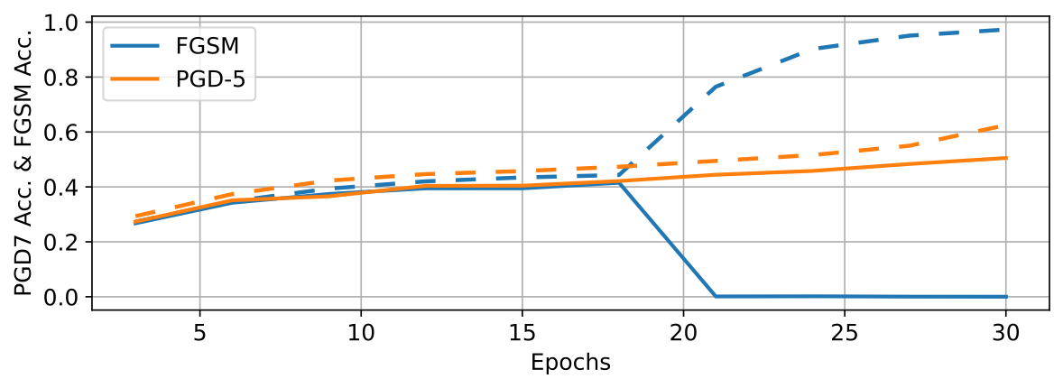
Catastrophic Overfitting
CIFAR10, PreactResnet18, $ϵ=8/255$
Robust Accuracy against multi-step attacks
FGSM
Robust Accuracy against single-step attacks
Fast is better than free: revisiting adversarial training [Wong 2020]

Slide 32
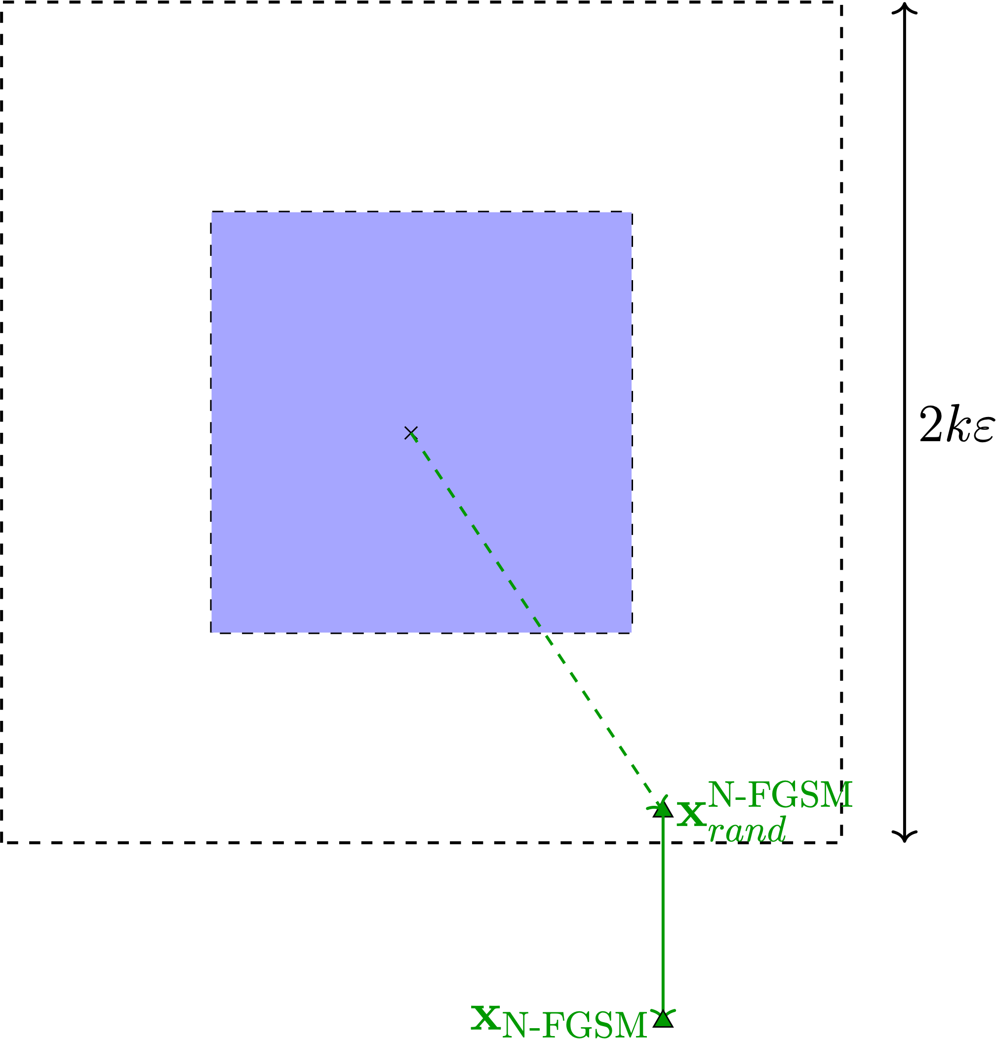
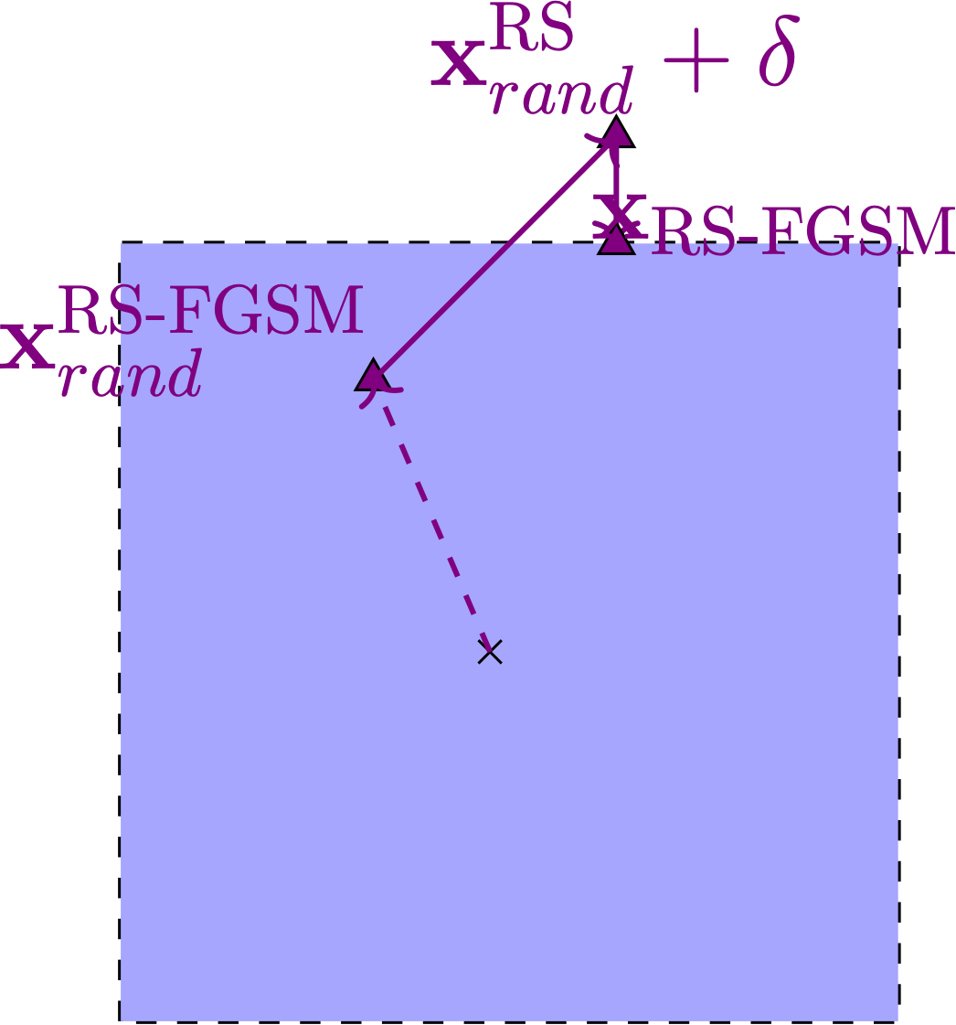
Mitigations
Noisy single steps attacks
RS-FGSM
N-FGSM
Fast is better than free: revisiting adversarial training [Wong 2020], Make Some Noise: Reliable and Efficient Single-Step Adversarial Training [De Jorge 2022]

Slide 33
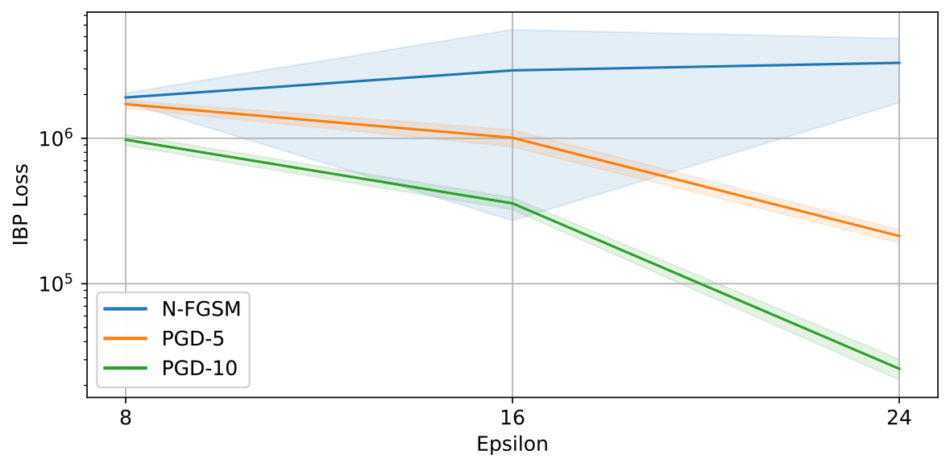
Over-approximations and catastrophic overfitting
CIFAR10, PreactResnet18. Mean and 95% CI over 5 runs
Bounds decrease with stronger attacks
Adding noise is not enough to consistently mitigate catastrophic overfitting?
Over-approximated output bounds

Slide 34
Over-approximations and catastrophic overfitting
Our proposal: use over-approximations at training time for empirical robustness
$$α=0$$
$$α=1$$
?
High verifiability!

Slide 35
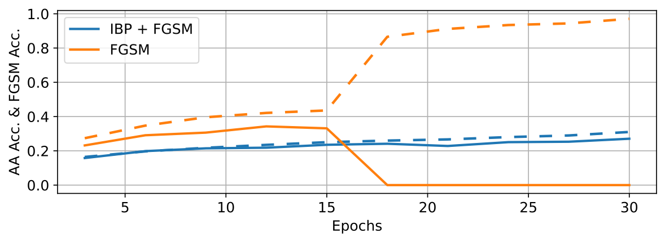
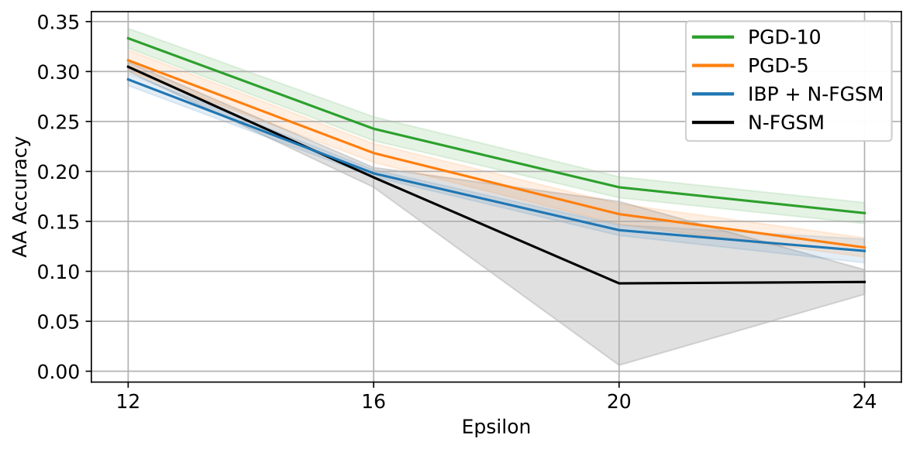
CT for Empirical Robustness
CIFAR10, PreactResnet18, $ϵ=8/255$
CT + FGSM can prevent catastrophic overfitting on FGSM
CT
CIFAR10, PreactResnet18
Also prevent CO and improves robustness for N-FGSM
CT

Slide 36
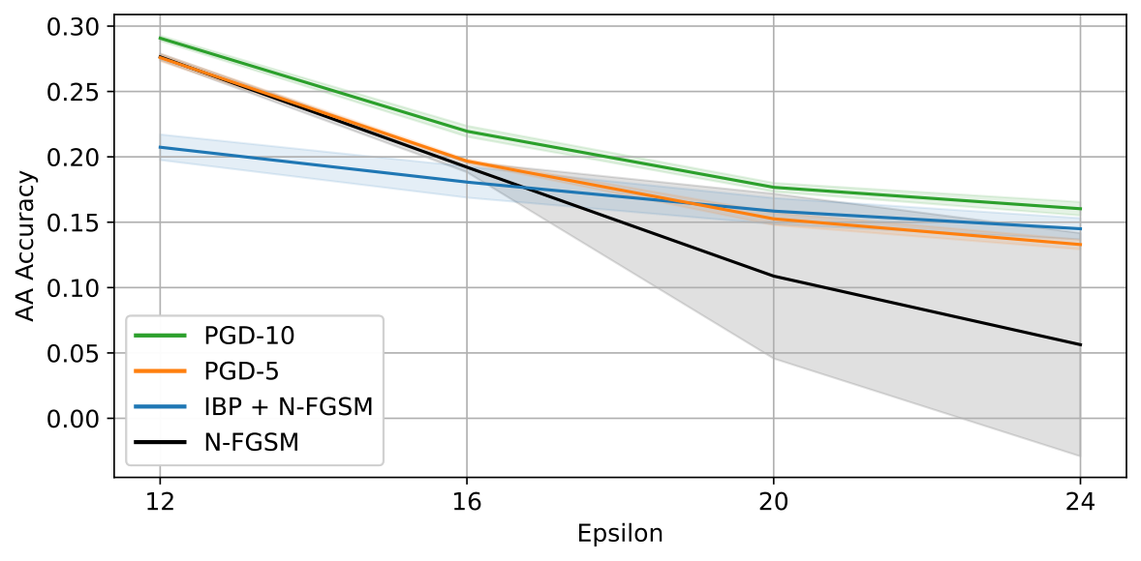
CT for Empirical Robustness
Performance improvement (w.r.t underlying attack):
On longer training schedules
On easier datasets
On shallower networks
CIFAR10, CNN-7, 30 Epochs
CIFAR10, CNN-7, 160 Epochs
Training Method | Empirical (%)
CT + N-FGSM | 14.79
CT + PGD-5 | 16.45
PGD-10 | 15.14
PGD-5 | 11.47
N-FGSM | 0.23
CT
Can over-approximations be used beyond robustness?

Slide 37
Over-approximations for Explainability
3

Slide 38
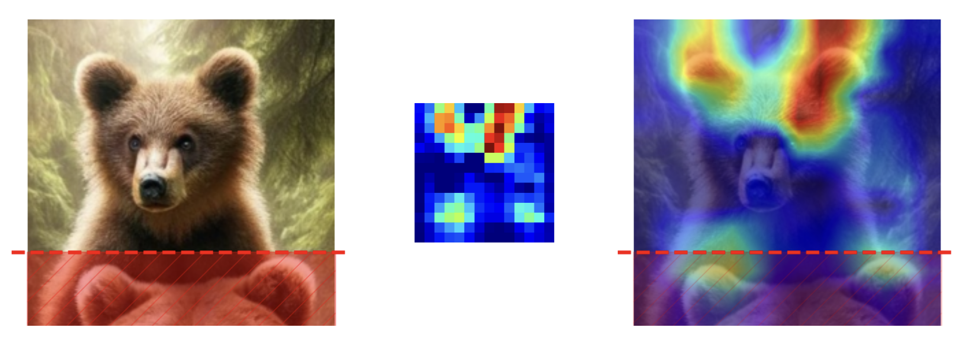
Feature Attributions
Right for the wrong reasons, the need for Explainability
Identify inputs contributing to the network’s decision: improve trust, help diagnose bad models …
But what if the method does not highlight truly important inputs?
CAM-Based Methods Can See through Walls [Taimeskhanov 2024]

Slide 39
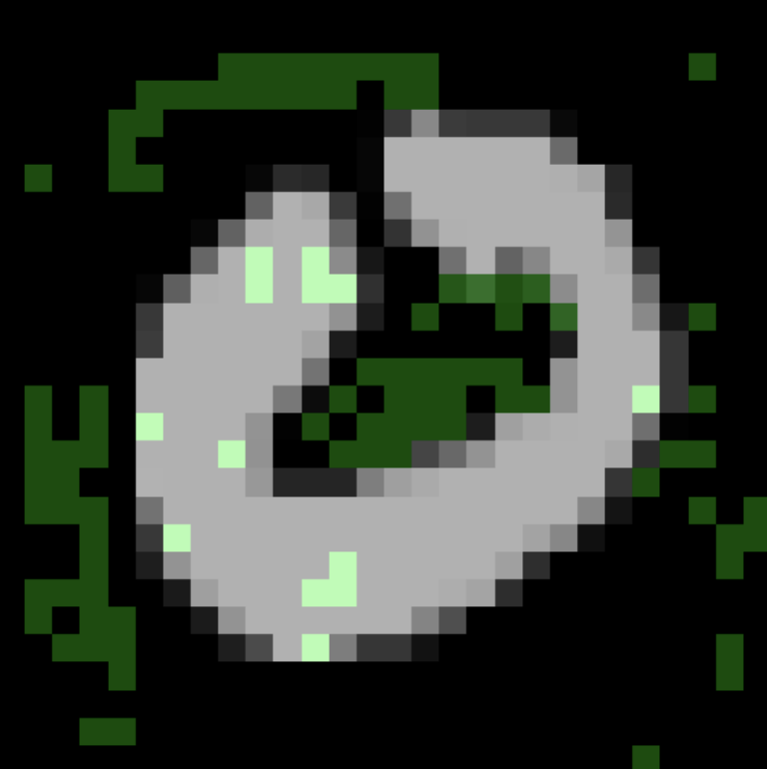
Formally Robust Explanations
Binary attribution: irrelevant or relevant
Irrelevant pixel: perturbing it (locally) does not change the prediction (= provable robustness!)
Subset-Optimal: if perturbing any new pixel together with the irrelevant features changes the prediction
Key metric: size of the irrelevant feature set (larger = simpler explanation)
Abduction-Based Explanations for Machine Learning Models [Ignatiev 2018]

Slide 40
Formally Robust Explanations
Candidate
Irrelevant
Relevant
Each step: solving a verification problem!
Active area of research to increase scalability
VeriX: Towards Verified Explainability of Deep Neural Networks [Wu 2023]

Slide 41
Over-approximations For Explainability
Use over-approximations for scalability?
Irrelevant
Relevant
Unknown
Too Many Unknowns!
VeriX: Towards Verified Explainability of Deep Neural Networks [Wu 2023], A dive into formal explainable attributions for image classification [Doncenco 2025]

Slide 42
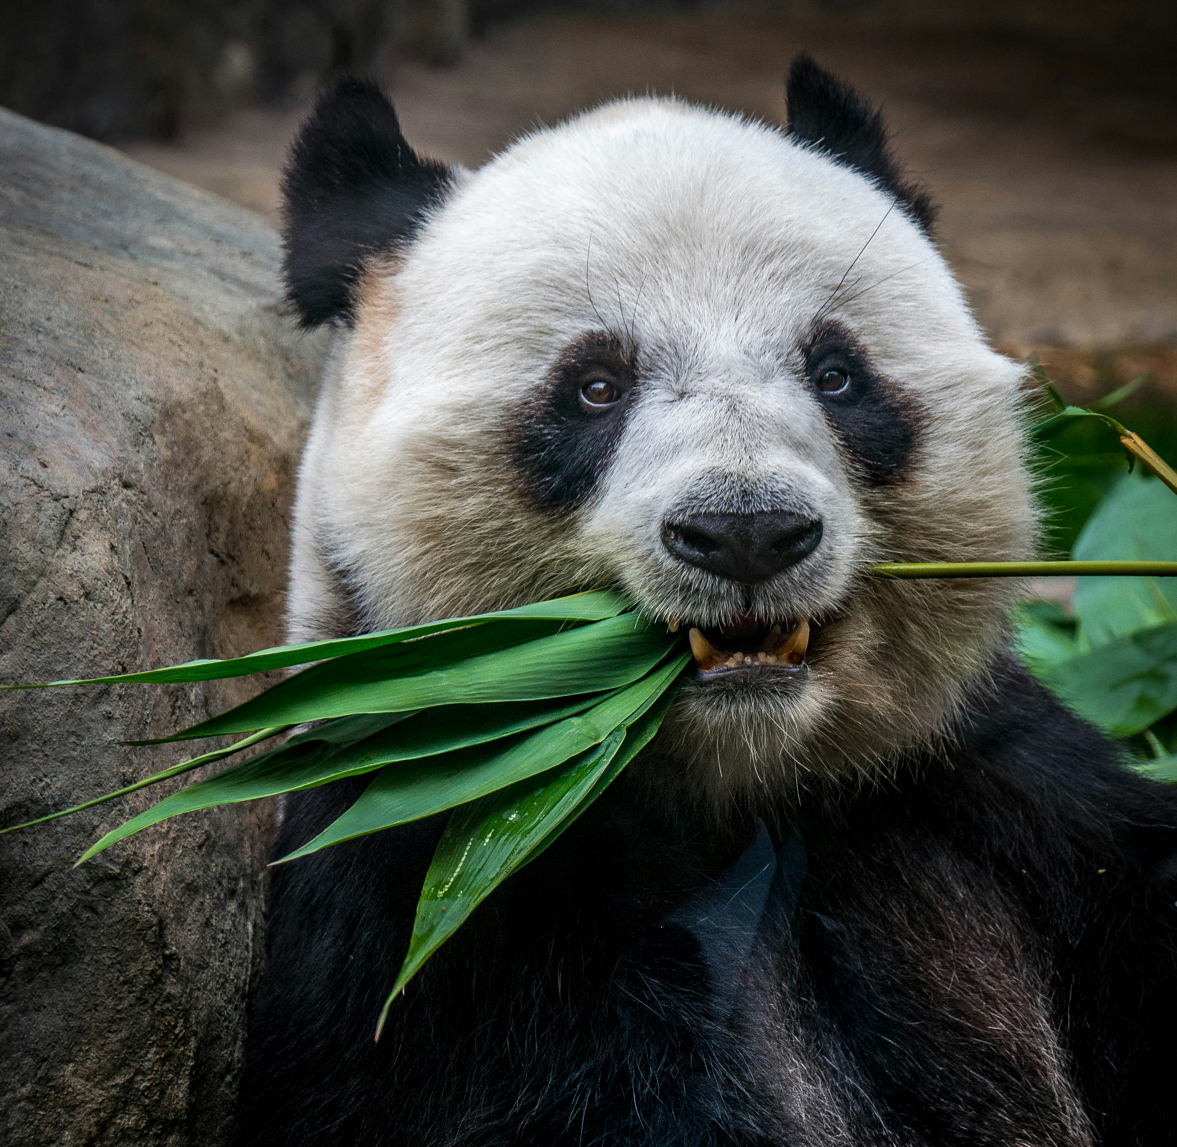


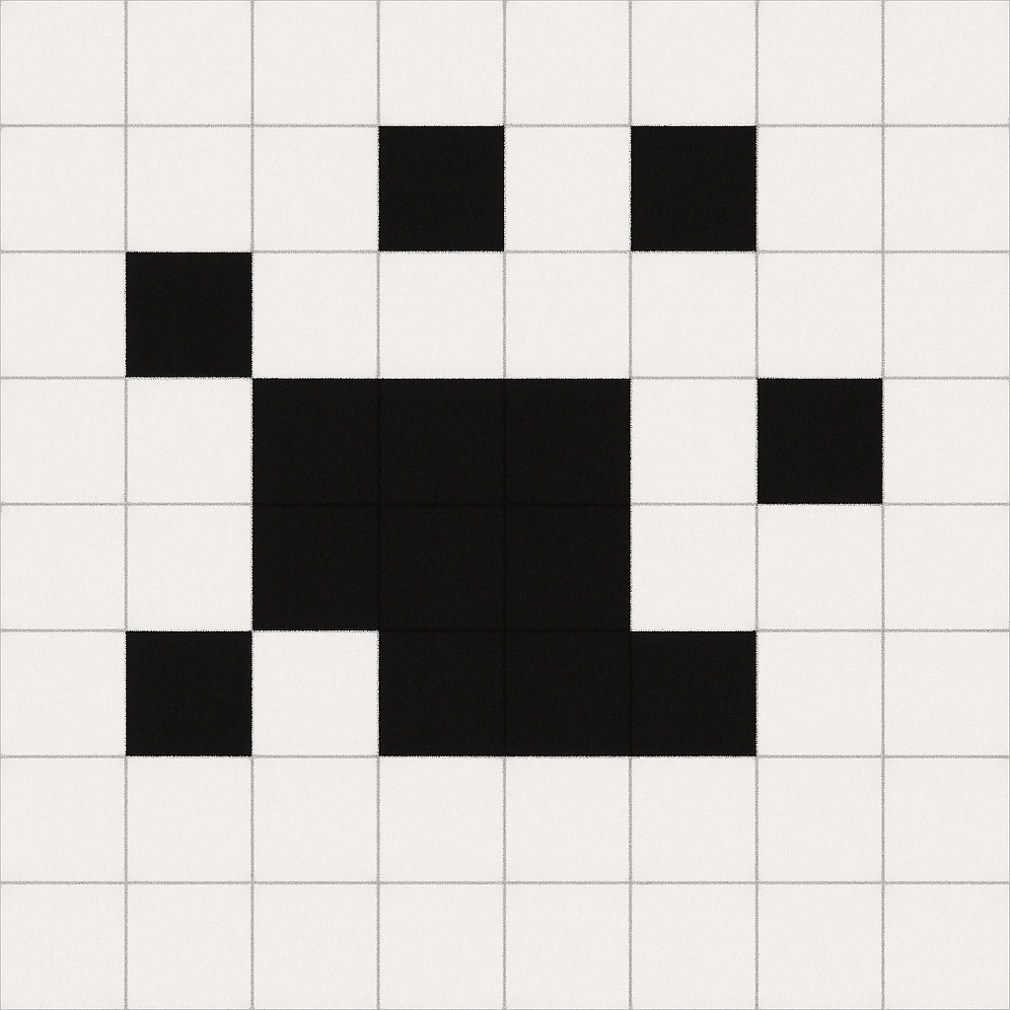
Lowering the robustness goal
Saliency map
Mask top k %
$$α$$
$$+$$
$$⊙$$
$$+$$
$$⊙$$
$$(1-α)$$

Slide 43
Over-approximations For Explainability
Use over-approximations for scalability?
Use robust models?
Everything Irrelevant!
Explanation is empty

Slide 44
Over-approximations For Explainability
Use over-approximations for scalability?
Use robust models?
Everything Irrelevant!
Explanation is empty
Unknowns might hide
this possibility!

Slide 45
Training For Explainability
Our propositions:
Make sure the entire input is Empirically Formally Explainable (EFX)
there exist a successful perturbation (empirically estimated)
there is at least one irrelevant feature (provably assessed with over-approximations)
Use robust training with lowered robustness goal to prevent full irrelevancy

Slide 46
Lowering the robustness goal
Adversarial training: lower the perturbation radius
Expressive Losses: lower the coefficient associated with the IBP loss
Train to be robust on a subset of inputs (Feature Subset Certified Training)
Saliency map
Mask top k %
$$α$$
$$+$$
$$⊙$$
$$+$$
$$⊙$$
$$(1-α)$$

Slide 47
Results
TinyImageNet, CNN-7
Perturbation | Training Method | Accuracy (%) ↑ | Avg Irrelevant set ↑ (# features: 4096) | # EFX(AA) ↑ (samples: 1000)
4 / 255 | Standard
 | Adversarial (1 / 255)
 | CT + Adv (0.5 / 255)
 | FS CT + Adv (2 / 255)
8 / 255 | Standard
 | Adversarial (4 / 255)
 | CT + Adv (1 / 255)
 | FS CT + Adv (4 / 255)

Slide 48
Results
TinyImageNet, CNN-7
Perturbation | Training Method | Accuracy (%) ↑ | Avg Irrelevant set ↑ (# features: 4096) | # EFX(AA) ↑ (samples: 1000)
4 / 255 | Standard | 54.80 | 23 | 990
 | Adversarial (1 / 255) | 52.61 | 340 | 911
 | CT + AT (0.5 / 255) | 44.79 | 804 | 947
 | FS CT + AT (2 / 255) | 48.60 | 506 | 996
8 / 255 | Standard | 54.80 | 6 | 887
 | Adversarial (4 / 255) | 41.41 | 263 | 925
 | CT + AT (1 / 255) | 42.36 | 465 | 988
 | FS CT + AT (4 / 255) | 44.49 | 684 | 998
Non-trivial irrelevant features set on TinyImageNet!
Feature Subset training offers better trade offs for large epsilon

Slide 49
Conclusion
3

Slide 50
Contributions
ReCIPH: a heuristic to improve verification relying on partitioning and over-approximations (Workshop Poster WFVML 2022)
Using Certified Training for Empirical Robustness (Journal TMLR 2025)
Using Certified Training to scale Formal Explainability (submission in preparation)

Slide 51
Future Work
Verification:
Automated input partitioning beyond bissection
Verification of more complex architectures
Verification of more complex properties
Robust training:
Re-visit tighter approximation for training?
Applications beyond robustness and explainability: contrastive learning, robust segmentation…
Formal Explainability:
True end to end learning of which input are relevant jointly with the robust training for explainability
Explore other notions than input level explanations -> in the latent space
Ever-going problem of efficiency
Ever-going problem of efficiency
Ever-going problem of efficiency

Slide 52
Future Work and important challenges
Verification
Automated input partitioning (beyond bissection)
Verification of more complex architectures
Verification of more complex properties
Robust training
Re-visit tighter approximation for training?
Applications beyond robustness and explainability: contrastive learning, robust segmentation…
Explainability
True end to end learning of which input are relevant jointly with the robust training for explainability
Explore other notions than input level explanations -> in the latent space
Ever-going problem of efficiency
Ever-going problem of efficiency
Ever-going problem of efficiency
On the Paradox of Certified Training [Jovanović 2021], Gaussian Loss Smoothing Enables Certified Training with Tight Convex Relaxations [Balauca 2024]
Robustness Verification for Transformers [Shi 2020]
Formal Abductive Latent Explanations for Prototype-Based Networks [Soria 2026]
Verifying Global Neural Network Specifications using Hyperproperties [Boetius 2023]

Slide 53
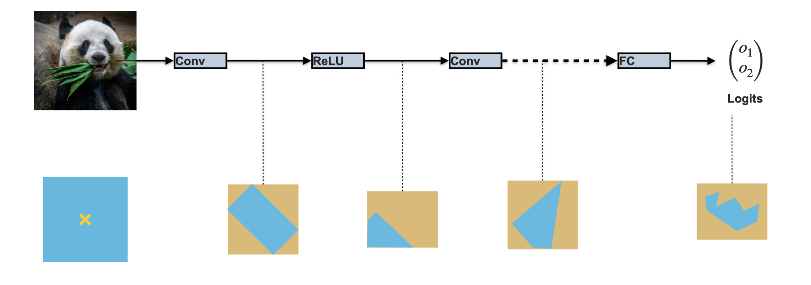
If you must only remember one thing
Over-approximations: versatile tool that can be leveraged in multiple ways to bring trust to AI systems
Trust should be an integral part of the design / training choices!
Questions ?

Slide 54
Additional content
4

Slide 55
LIBRA (Fairness)
 |  | Coverage (%) |  | Execution Time (s)
L | U | Width | ReCIPH | Width | ReCIPH
1 | 2 | 68.8% | 87.5 % | 0.26 | 0.11
 | 6 | 68.8% | 87.5 % | 0.51 | 0.20
4 | 2 | 100 % | 100 % | 2.60 | 2.10
 | 6 | 100 % | 100 % | 2.65 | 2.10
LIBRA https://caterinaurban.github.io/project/libra/
Notes:
Tool for Fairness Certification of Neural Networks
First step: input partitioning and forward analysis using abstract domains (i.e. linear approximations)
On sub-problems where # instable ReLU is low enough: complete backward analysis to certify fairness
End-result: fairness coverage of entire input space

Slide 56
VNN Comp 2024
PyRAT with ReCIPH input partitioning is used for 6 out of 12 benchmarks
Benchmark | PyRAT Rank | Notes
cGAN | 1 / 6 | First rank position are shared with at least one other tool. Global ranking was 2 out of 8 submitted tools
LinearizeNN | 1 / 4
Collins RUL CNN | 5 / 7
TLL Verify Bench | 1 / 8
ACAS Xu | 3 / 8
Dist Shift | 1 / 5
Verification is still a hard challenge!
VNN Comp 2024 report https://arxiv.org/abs/2412.19985
Notes:
Transition :
Verification remains a very active field. Standardly trained network are very challenging to verify.
Orthogonally to verifying network post-training, there is an area of research dedicated to inducing robustness during training.

Slide 57
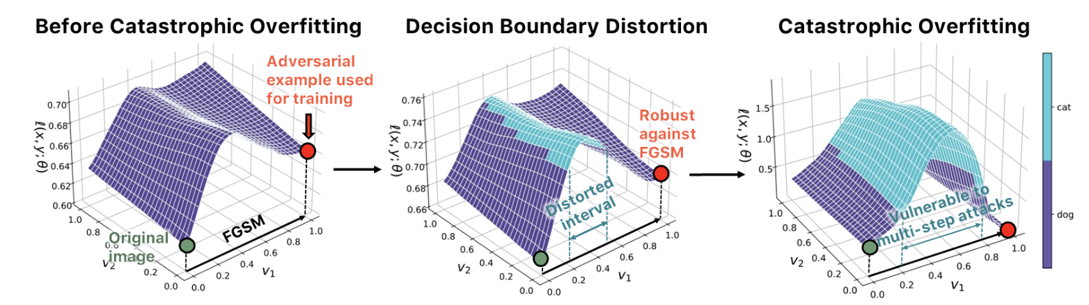
Local Linearity and Catastrophic Overfitting

Slide 58
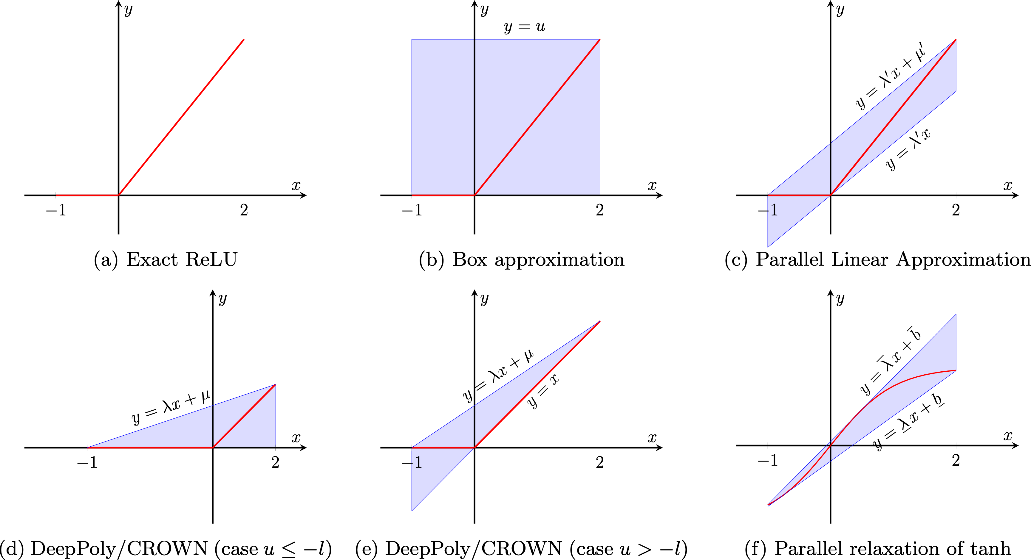
Source of approximations: handling of the non-linearities (activation functions)
Parallel: WK [Wong2017], FastLin [Weng2018], Neurify [Wang2018], DeepZ [Singh2019], CROWN [Zhang 2018], DeepPoly [Singh 2019]
(Non-exhaustive list)

Slide 59
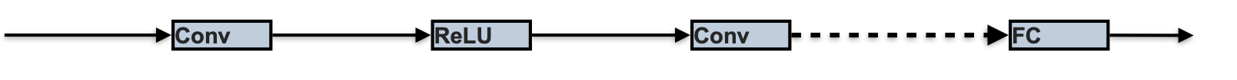

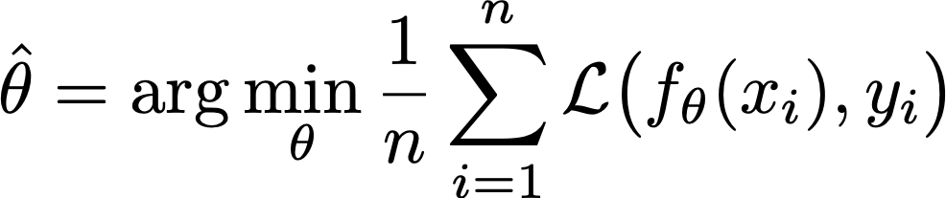

Supervised Training (Classification)
Not Panda
$$f_{θ}$$
$$\left(\begin{aligned}o_{1} \\ o_{2}\end{aligned}\right)$$
$$f_{θ}(x)$$
(Logits)
Panda
$$x$$
Estimation of the error of the model (using a surrogate loss function)
Goal: empirical risk minimization. Expectation of the loss function over the dataset
Gradient Descent: Update of the parameters in the opposite direction of the gradient to minimize the error. Stochastic Gradient Descent (SGD): compute the gradients and do the update over small batch of inputs randomly drawn from the dataset. One epoch = one full pass over the dataset

Slide 60
Supervised Training (Classification)
Not Panda
$$f_{θ^{′}}$$
$$\left(\begin{aligned}o_{1}^{′} \\ o_{2}^{′}\end{aligned}\right)$$
Panda
$$x$$
Estimation of the error of the model (using a surrogate loss function)
Update of the parameters to minimize the error

Slide 61
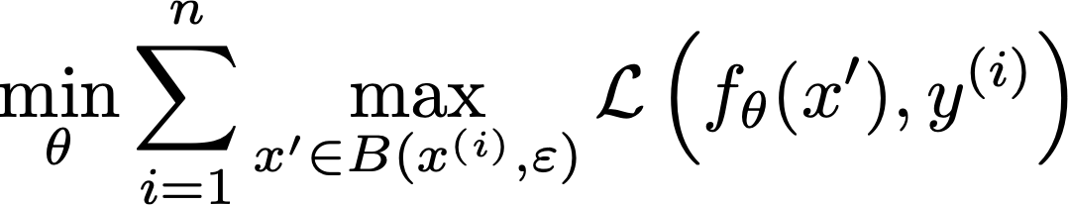
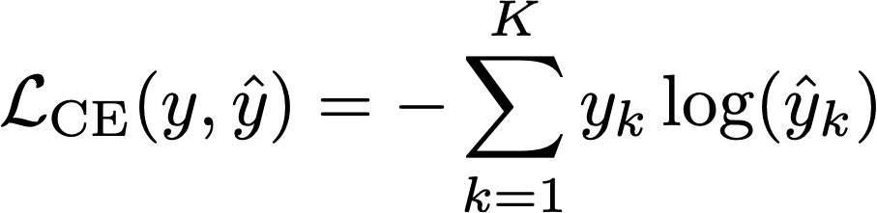


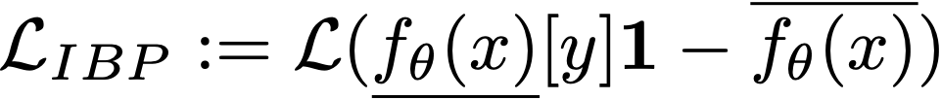
Robust Learning, more formally
[Madry 2018] Goal of robust training:
= typically the cross-entropy
Adversarial training: under-approximate solution of inner-maximization using some attack algorithm
Certified training: over-approximate solution using differentiable bounding algorithm (in practice IBP)
with $x_{adv}$ an adversarial perturbation
with $\overline{f_{θ}(x)}$ and $\underset{¯}{f_{θ}(x)}$ the output bounds computed with IBP

Slide 62
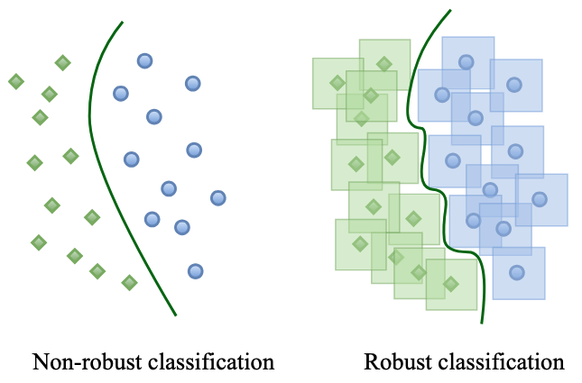

Slide 63
Interval Bound Propagation

Slide 64

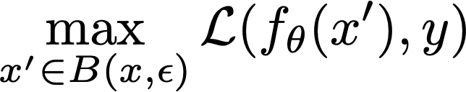


Expressive Losses
$$α=0$$
$$α=1$$
Different ways of combining have been proposed:
MTL-IBP
CC-IBP
Exp-IBP
Expressive Losses for Verified Robustness via Convex Combinations [De Palma 2024]

Slide 65
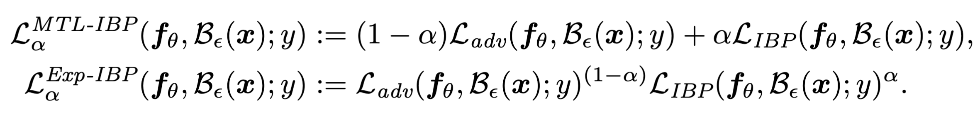
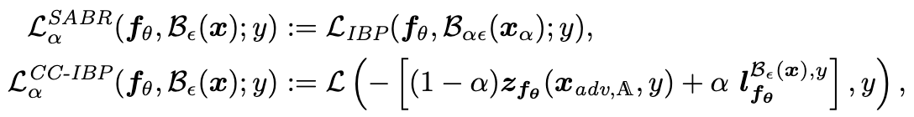
Expressive Losses

Slide 66
Trade Offs of CT + AT in CO setting

Slide 67
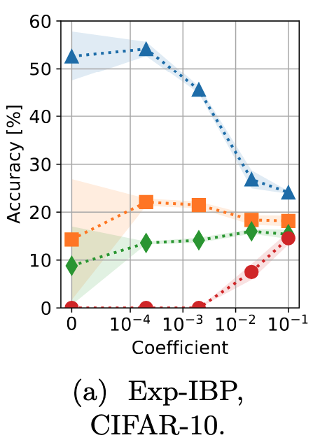
Sensitivity of CT + AT to $α$

Slide 68
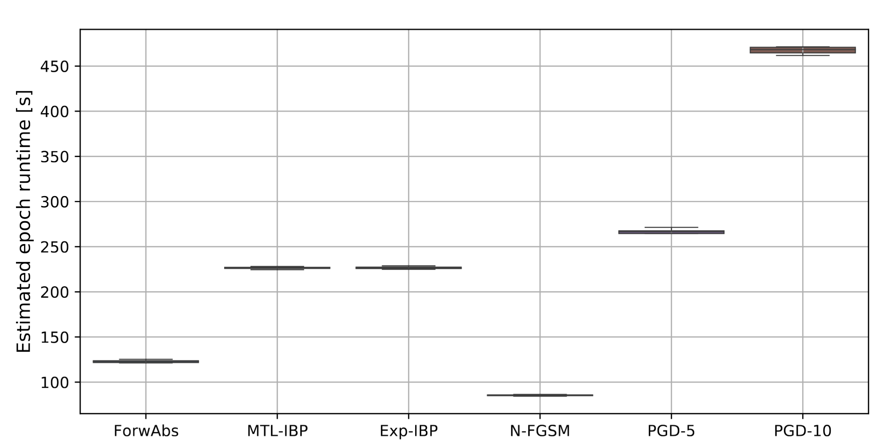
Time trade offs

Slide 69
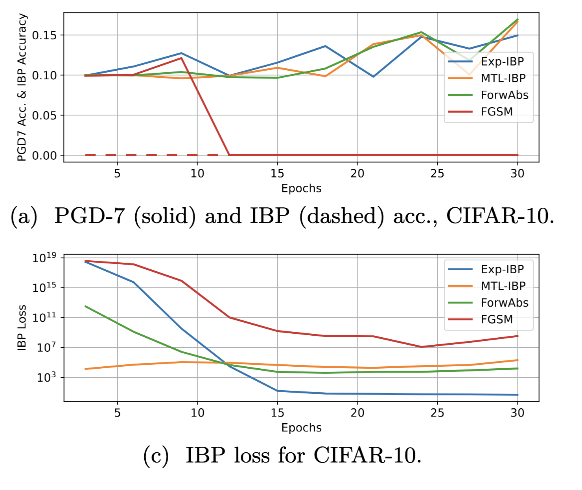
Prevent CO in Softplus networks

Slide 70
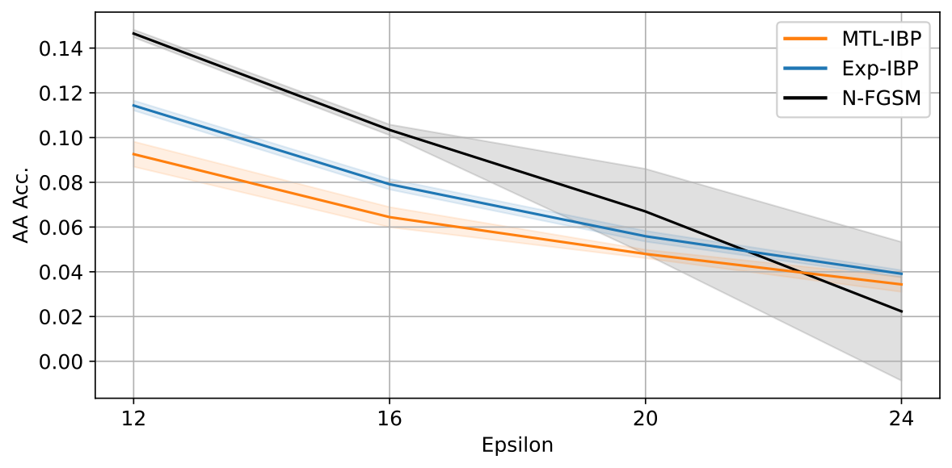
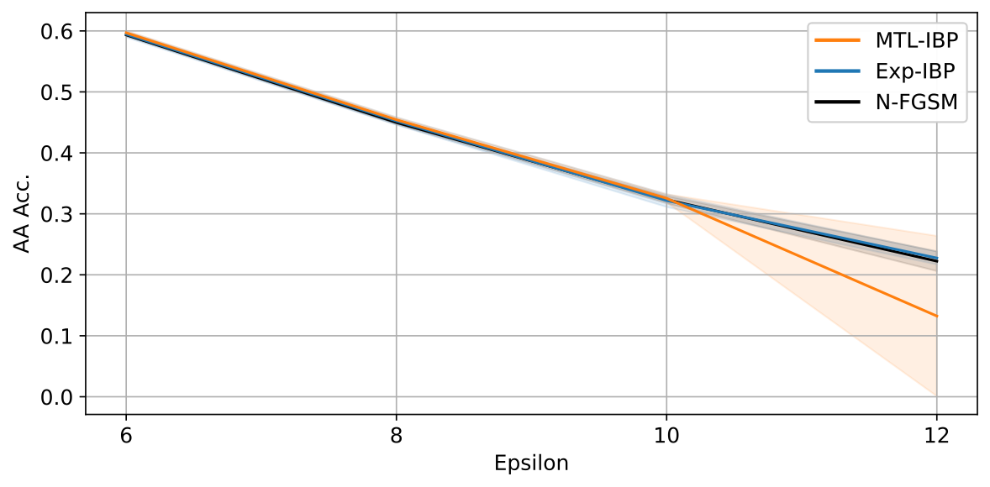
Limits
CIFAR-100
CIFAR SVHN
On CIFAR-100: CO is mitigated, but high cost in empirical robustness (tuning adapted to the epsilon could help)
On SVHN: MTL-IBP fails. MTL-IBP tuning is very sensitive compared to Exp-IBP, especially for deep networks.

Slide 71
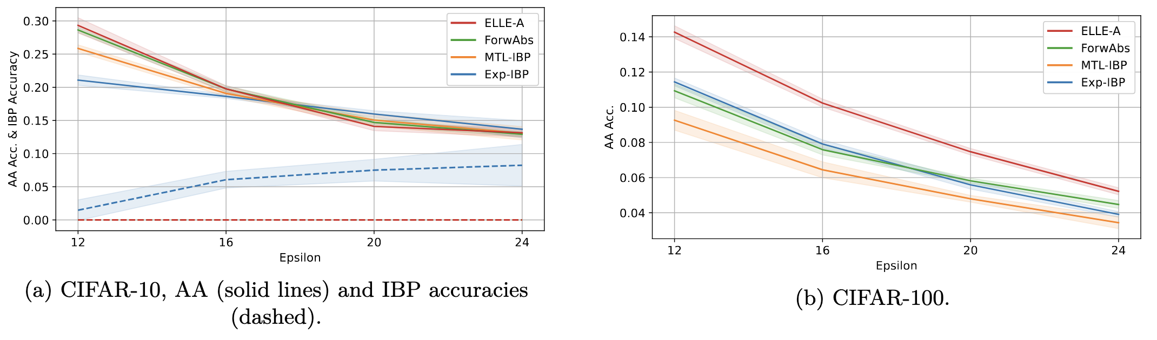
Comparisons with ELLE

Slide 72
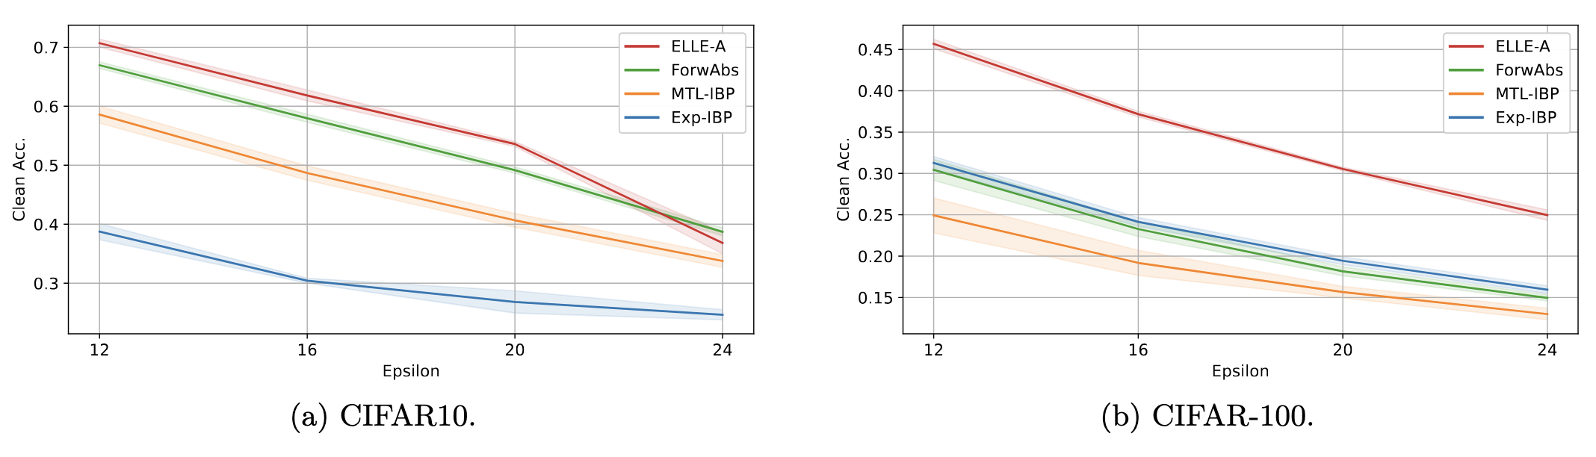
Comparisons with ELLE

Slide 73
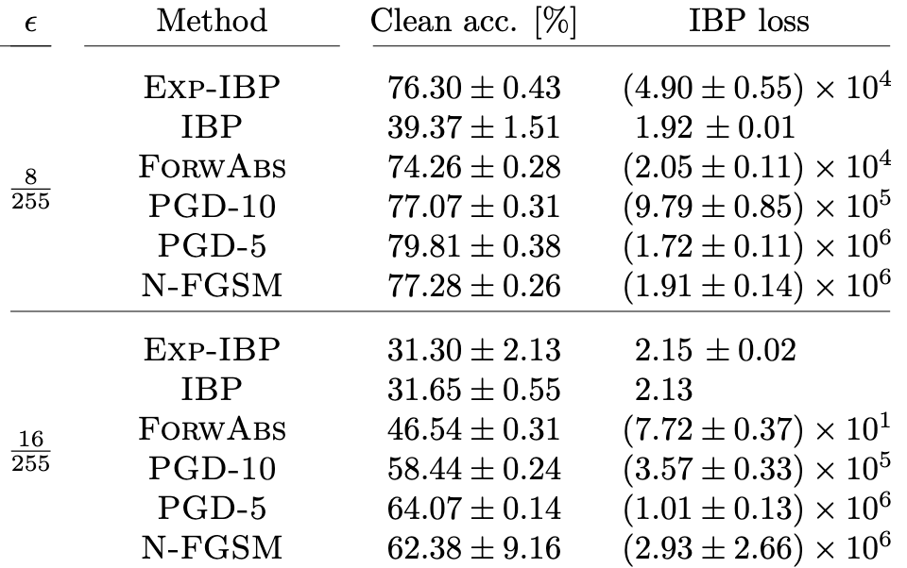
Some clean accuracies
CIFAR-10, CNN-7, 160 epochs

Slide 74

Low Epsilon on standard network?

Slide 75

ReCIPH as traversal order

Slide 76




Qualitative Results
FS+CT+AT
CT + AT
AT

Slide 77

Robustness and XAI 1

Slide 78

Robustness and XAI 2

Slide 79

Robustness and XAI 2

Slide 80

Robustness and XAI 3

